Slide 1
DocFX – Markdown-based documentation tool (for .Net and not only)
Mihail Romanov
Senior programmer

Slide 2



Who is documentation consumer?
Programmer
User

Slide 3
What we talk about?
Markdown
DocFX
DocFX Internals and Extensions

Slide 4
Markdown

Slide 5
A lightweight markup language with plain text formatting syntax

Slide 6
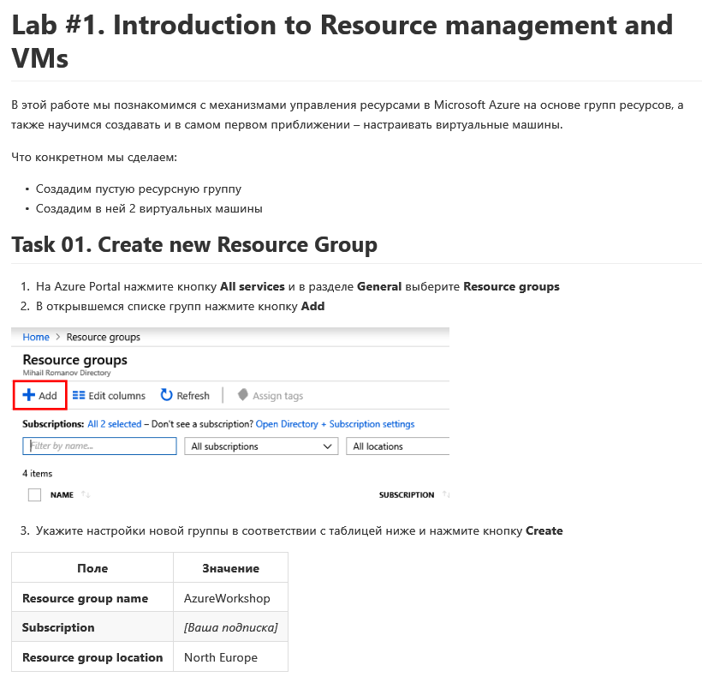
# Lab #1. Introduction to Resource management and VMs
В этой работе мы познакомимся с механизмами управления ресурсами в Microsoft Azure на основе групп ресурсов, а также научимся создавать и в самом первом приближении – настраивать виртуальные машины.
Что конкретном мы сделаем:
- Создадим пустую ресурсную группу
- Создадим в ней 2 виртуальных машины
## Task 01. Create new Resource Group
1) На Azure Portal нажмите кнопку **All services** и в разделе **General** выберите **Resource groups**
2) В открывшемся списке групп нажмите кнопку **Add**
![Add resource group](../images/lab1/image2.png)
3) Укажите настройки новой группы в соответствии с таблицей ниже и нажмите кнопку **Create**
|Поле|Значение|
|---|---|
|**Resource group name**| AzureWorkshop |
|**Subscription**| _[Ваша подписка]_|
|**Resource group location**| North Europe|

Slide 7
Why Markdown?
Simple
Sufficient for simple texts
Easy render to HTML (and not only)
Allow HTML embedding
Support in «developers» systems
Track / VCS / …
Notes:
Простой
в сравнении HTML/XML/LaTeX/…
Достаточный для простых текстов
форматирование текста / гиперссылки / media / таблицы / …
Множество рендеров (в HTML)
VCS: GitHub / GitLab, TFS Services, …
Допускает вставку HTML

Slide 8
Demo
Notes:
https://github.com/MihailRomanov/System_Programming_Course
https://github.com/MihailRomanov/OS_Course

Slide 9


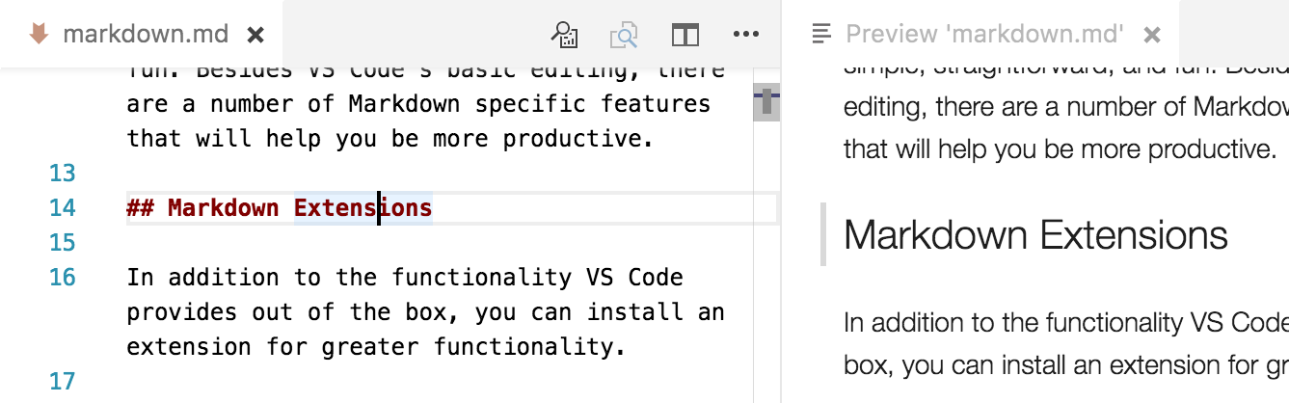
Tools
Visual Studio
Markdown Editor
Visual Studio Spell Checker
Visual Studio Code
out of the box
+ Some extensions

Slide 10
Demo
Notes:
Demo_2
Open in VS as folder
Show .editorconfig
Open 01_New_system_call.md
Add new header and text – show preview in Markdown editor
Show typo and spellchecking
Make screenshot, insert in new image
Add reference to image md

Slide 11
What need we more???
Docs from code
XML comments / JavaDoc / …
Titles of Content (TOC)
Search
Host not only on GitHub / Azure DevOps / …
Own site / Offline-version
…

Slide 12
DocFx
https://github.com/dotnet/docfx
https://dotnet.github.io/docfx/

Slide 13
A documentation generation tool for API reference and Markdown files!

Slide 14
How it works…
*.csproj
*.vbproj
Built-in
Site
Build pipeline
Metadata
in
YAML
PDF
Custom extractor
Other languages
*.md
Images
TOC

Slide 15



Let’s start... Installation
https://github.com/dotnet/docfx/releases
https://www.nuget.org/packages/docfx.console/
choco install docfx

Slide 16
Commands
Docfx.exe
init
build
metadata
pdf
template
serve

Slide 17
Demo
Notes:
Demo_3
git clone https://github.com/MihailRomanov/PowerCollections
Nuget restore
docfx init -o doc
Change in docfx.json
"src": [
{
"files": [
"**.csproj"
],
"src" : "../src/"
}
],
copy src/Home.md to doc/index.md
Open in VS and small fix index.md
docfx
Show site
Api
Navigation
Change in docfx.json
"pdf": {
"content": [
{
"files": [
"api/**.yml",
"articles/**.md",
"index.md",
"pdf/toc.yml"
]
}
],
"resource": [
{
"files": [
"images/**"
]
}
],
"dest": "_site_pdf"
}
Add file pdf/toc.yml
- name: Intro
href: ../index.md
- name: Articles
href: ../articles/toc.yml
- name: Api Documentation
href: ../api/toc.yml
docfx pdf

Slide 18
DoсFx = Markdown + …
… API metadata from XML Documentation Comments
… TOC and references
… API documentation out of code
… Markdown Extensions
… Community features
…

Slide 19
API metadata (built-in: .Net)
docfx.json
"metadata": [
{
"src": [
{
"src": "../src/",
"files": [ "**.csproj" ],
"exclude": [ "**Tests.csproj" ]
}
],
"dest": "api"
}
],
"build": {
"xrefService":
[ "https://xref.docs.microsoft.com/
query?uid={uid}" ]
},

Slide 20
API metadata (Other languages)
src
Doc tool
“Native“ metadata
To YAML
DocFx metadata
TS:
typedoc – extract metadata
type2docfx – convert to DocFx YAML
https://github.com/docascode

Slide 21
Demo
Notes:
Demo_04

Slide 22
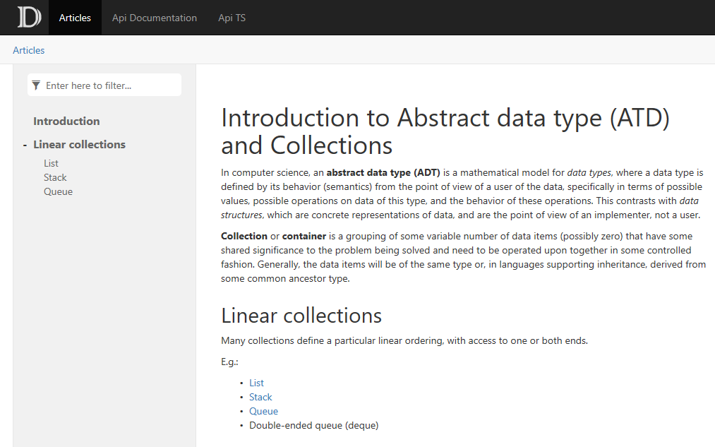
TOC and references

Slide 23
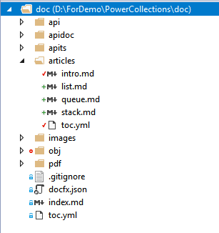
TOC hierarchy
- name: Introduction
href: intro.md
- name: Linear collections
items:
- name: List
href: list.md
- name: Stack
href: stack.md
- name: Queue
href: queue.md
- name: Articles
href: articles/
- name: Api Documentation
href: api/
homepage: api/index.md
- name: Api TS
href: apits/

Slide 24
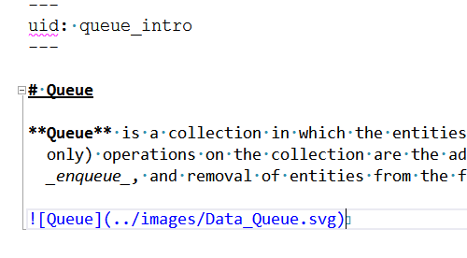
References
References: relative, absolute, xref
- [List](list.md)
- [Stack](~/articles/stack.md)
- [Queue](xref:queue_intro)
- [Deque](xref:Wintellect.PowerCollections.Deque`1),
- [MultiDictionary](xref:Wintellect.PowerCollections.MultiDictionary`2),
- [Bag](xref:Wintellect.PowerCollections.Bag`1),
- [OrderedBag](xref:Wintellect.PowerCollections.OrderedBag`1),

Slide 25
Demo
Notes:
Demo_05

Slide 26

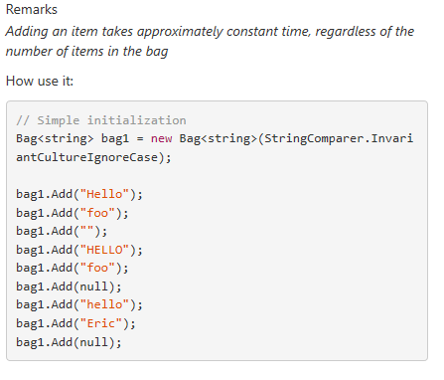
API documentation out of code
/// <summary>
/// Adds a new item to the bag. Since bags can contain duplicate
/// items, the item
/// is added even if the bag already contains an item equal
/// to <paramref name="item"/>. In
/// this case, the count of items for the representative item is
/// increased by one, but the existing
/// represetative item is unchanged.
/// </summary>
/// <remarks>
/// <para>Adding an item takes approximately constant time,
/// of the number of items in the bag.</para></remarks>
/// <param name="item">The item to add to the bag.</param>
public sealed override void Add(T item)
{
}

Slide 27
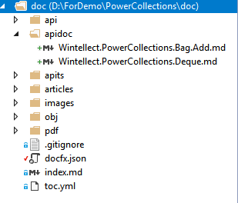
API documentation out of code
"overwrite": [
{
"files": [
"apidoc/**.md"
]
}
]
---
uid: Wintellect.PowerCollections.Bag`1.Add(`0)
remarks: *content
---
_Adding an item takes approximately constant time, regardless of the number of items in the bag_
How use it:
```C#
// Simple initialization
Bag<string> bag1 = new Bag<string>(StringComparer.InvariantCultureIgnoreCase);
```

Slide 28
Demo
Notes:
Demo_06

Slide 29
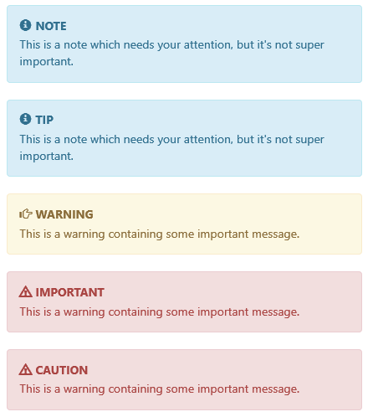
Markdown Extensions (notes)
> [!Warning]
> Codeplex is retried and work in archive mode.
> [!Note]
> Codeplex is retried and work in archive mode.

Slide 30
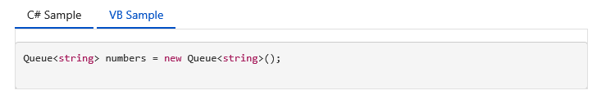
Markdown Extensions (tabs)
# [C# Sample](#tab/tab1)
```CSharp
Queue<string> numbers = new Queue<string>();
```
# [VB Sample](#tab/tab2)
```VB
Dim numbers As New Queue(Of String)
```
***

Slide 31
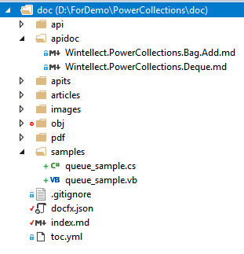
Markdown Extensions (code snippets)
[!code[Sample](../samples/queue_sample.cs?range=8-19&highlight=2)]
[!code[Sample](../samples/queue_sample.cs?name=Sample2)]
#region Sample2
// Create a copy of the queue, using the ToArray method and the
// constructor that accepts an IEnumerable<T>.
Queue<string> queueCopy = new Queue<string>(numbers.ToArray());
Console.WriteLine("\nContents of the first copy:");
foreach (string number in queueCopy)
{
Console.WriteLine(number);
}
#endregion

Slide 32
Demo
Notes:
Demo_07

Slide 33
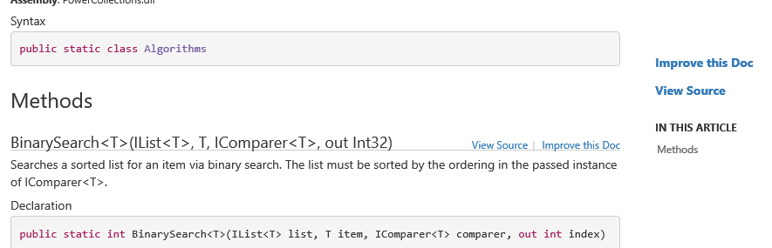
Community features
"globalMetadata": {
"_disableContribution": false,
"_gitContribute": {
"apiSpecFolder" : "apidoc"
},
"_appTitle": "demo_08"
}

Slide 34
Demo
Notes:
Demo_08

Slide 35
DocFX Internals and Extensions

Slide 36
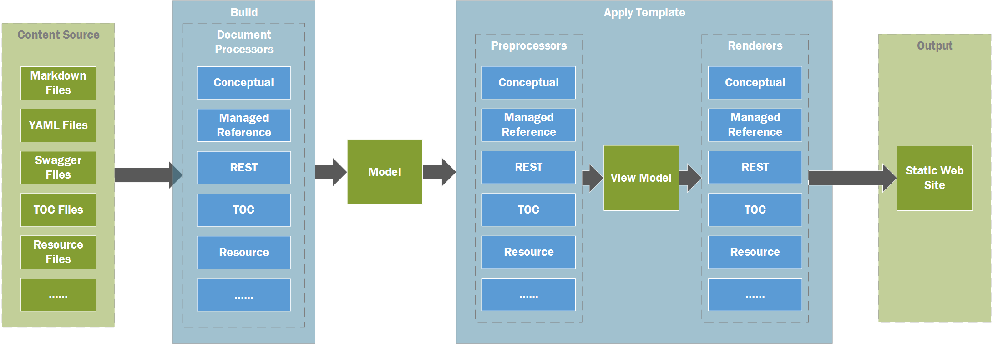
Build pipeline

Slide 37
Model sample
{ "conceptual": "\n<p sourcefile=\"index.md\" sourcestartlinenumber=\"3\">Утилита позволяет нарезать видео, ", "type": "Conceptual", "source": { "remote": { "path": "Documentation/index.md", "branch": "master", "repo": "https://github.com/MihailRomanov/PPTXToVideo.git" }, "startLine": 0.0, "endLine": 0.0, "isExternal": false }, "path": "index.md", "_docfxVersion": "2.40.8.0", "_systemKeys": [ "conceptual", "type", "source", "path", "documentation", "title", "rawTitle", "wordCount" ], "title": "Конвертер видео для курсов", "rawTitle": "<h1 id=\"конвертер-видео-для-курсов\" sourcefile=\"index.md\" sourcestartlinenumber=\"1\">Конвертер видео для курсов</h1>", "wordCount": 10.0, "_lang": "csharp", "_tocPath": "toc.html", "_navPath": "toc.html", "_rel": "", "_path": "index.html", "_key": "index.md", "_navRel": "toc.html", "_tocRel": "toc.html", "_navKey": "~/toc.yml", "_tocKey": "~/toc.yml", "_disableToc": true, "docurl": "https://github.com/MihailRomanov/PPTXToVideo/blob/master/Documentation/index.md/#L1" }
# Конвертер видео для курсов Утилита позволяет нарезать видео, сгенерированное из **Power Point** ![Sample](images/image1.png) [Читайте здесь!](articles/intro.md)

Slide 38
How explore / trace pipeline
docfx build --loglevel Verbose --exportRawModel --exportViewModel
Before build, delete
obj
_site
index.html
index.raw.json
index.html.view.json

Slide 39
How extend?
Markdown engine extensions
Custom document processor
Schema-driven Document Processor
Custom preprocessor
Template / Template part

Slide 40
Standard Templates
Default (built-in) templates
common
default(zh-cn)
default
pdf.default
statictoc
"template": [ "default", "..\\XsdProcessorExtensionLib\\template" ],
docfx template list
docfx template export

Slide 41
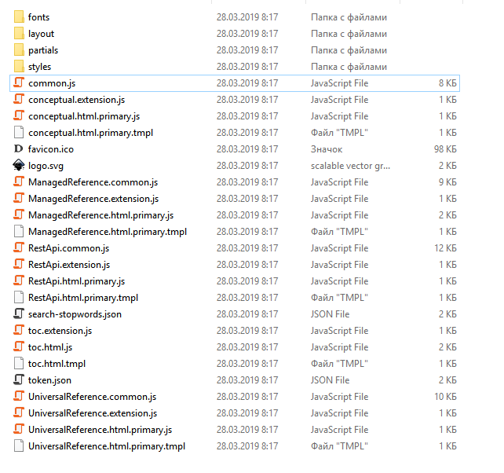
Template
Static files
css / fonts / icons
json
JS
HTML templates
Preprocessor files (js)

Slide 42
HTML template processing
Engine(s)
View model
HTML
Template(s)

Slide 43
Template engines
Mustache engine
Liquid engine
{{!master(layout/_master.tmpl)}}
<h1>{{title}}</h1>
{{#types.0}}
<h2 class="parameters">Types</h2>
<table class="table table-bordered table-striped table-condensed">
<thead>
<tr>
<th>Type</th>
<th>Description</th>
</tr>
</thead>
<tbody>
{{/types.0}}
{{#types}}
<tr>
<td>{{name}}</td>
<td>{{annotation}}</td>
</tr>
{{/types}}
{{#types.0}}
</tbody>
</table>
{{/types.0}}
<ul id="products">
{% for product in products %}
<li>
<h2>{{ product.name }}</h2>
Only {{ product.price | price }}
{{ product.description | prettyprint | paragraph }}
</li>
{% endfor %}
</ul>

Slide 44
Demo

Slide 45
https://github.com/MihailRomanov/TechTalks_DocFx
Mihail Romanov
Senior programmer
Romanov.m@skbkontur.ru

